Slide 1


Slide 2



The Team
Amit Aharoni
27, Pardesiya
3rd year C.S. student
Knowledge in C#, JavaScript, C
Sports fan, likes solving problems
GitHub: AmitAharoni
Nadav Suliman
27, Ra’anana
3rd year C.S. student
Knowledge in Java, JavaScript, HTML/CSS
Likes basketball, CTFs, Gaming
GitHub: nadavsu
Tamir Houri
26, Ramat Gan
2nd year C.S. student
Knowledge in C++, C
Likes running, watching Netflix, diving
GitHub: Tamirho

Slide 3


The Team
Daniel Malky
23, Holon
2nd year C.S. student
Knowledge in C, C++
Likes movies & snooker
GitHub: DanielMy777
Micha Levy
24, Modi’in
2nd year C.S. student
Knowledge in C, C++
Likes watching Netflix
GitHub: Micha546

Slide 4
Project background
Motivation
The demand for living in major cities is high and expensive.
Most of the people in their early 20s and 30s, prefer to live with roommates.
People are wasting their time searching unsuccessfully for roommate apartments, going through several platforms. Moreover, there's no perfect formula for choosing a good roommate. In most cases, the roommates find themselves splitting up because of a mismatch.
Finding great roommates to live with shouldn’t be that hard.
Use roo.me!

Slide 5
Project background
Goal
Create a fast, comfortable and easy way to find roommate apartments.
User friendly apartment-oriented search mechanism.
Easy ‘YES / NO’ interface.
A matching algorithm based on your preferences and hobbies.
Create connections with potential roommates.
Live chat.
Help both ‘owners’ and ‘seekers’ searching for roommates.
All in order to make the search experience lovely and enjoyable.

Slide 6








Architecture
Frontend
HTML
CSS
JavaScript
Bootstrap
Backend
Python
Django Vagrant
Database
SQLite

Slide 7
Architecture
More info | Description | Component
[1] | Standard markup language for documents designed to be displayed in a web browser. Used to create templates through the entire project. | HTML | Frontend
[2] | Used for describing the presentation of a document written in a markup language. Handled design over all web pages in the project. | CSS
[3] | Programming language that conforms to the ECMAScript specification. Like CSS, Handled dynamic design over all web pages in the project. | JavaScript
[4] | Bootstrap is a free and open-source CSS framework directed at responsive, mobile-first front-end web development | Bootstrap
[5] | Open-source software product for building and maintaining portable virtual software development environments. | Vagrant | Backend
[6] | Python-based free and open-source web framework that follows the model-template-views (MTV) architectural pattern. Used to handle all logic and redirecting in the project. | Django
[7] | Interpreted high-level general-purpose programming language. Most of the project was written in Python. | Python
[8] | Relational database management system. All of the models and tables of the project are saved in SQLite. | SQLite | Database

Slide 8
Project Structure
Templates (HTML)
Client Side
App Logic
View
Logic
Server Side
Models
Database
Database

Slide 9



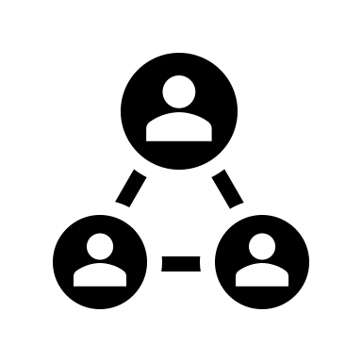

Features
Account management
Search mechanism
Intelligent roommate matching
Connecting between users
Live chat

Slide 10
Development processing
Idea development
Requirement specification
Setup the dev-env
Search app
Seekers app
Apartments app
base User app
Design and build
the ORM
Each app flow:
Built tests
Created the views.
Created the templates.
connections app
Developed Chat
roo.me

Slide 11
Challenges & What did we learn
Collaboration as a team.
Working asynchronous (via slack).
Using Git & GitHub with the CI concept.
Design and build an application from scratch.
Learning new technologies (Vagrant, Django, Bootstrap and etc).
Working with deadlines.

